Slide 1
Approximation Algorithm for Capacitated and Uncapacitated K-Center Problem
Sahel Vahedi Nouri, Arsalan Firoozi

Slide 2
Outline
K-Center Problem
Discrete and Continuous
History
Uncapacitated Problem – Greedy Algorithm
Uncapacitated Problem – Parametric Pruning
Capacitated Problem – 9-Approximation Algorithm
Uniform Capacitated Problem – L-Approximation Algorithm
K-Center
Problem
Discrete
Continuous
Capacitated
Uncapacitated

Slide 3
K-Center Problem
Notes:
Undirected, Weighted Graph
Distance Metric ➔ Triangle Inequality
Choosing K nodes and assigning nodes to centers
NP-hard ➔ ➔ Approximation Algorithms

Slide 4
Discrete and Continuous
Discrete:
Choosing k vertices
Continuous:
Locating coordinates of the center
Minisum:
Objective function: sum of distances
Minimax:
Objective function: maximum of distances
Uncapacitated:
No limit on nodes each centers can serve
Capacitated:
Each center has a capacity on the number of clients

Slide 5
History
“Given three points in a plane, Find a fourth point such that the sum of its distances to the three given points is minimized.“ Ferma, 1600-1665
Geometrical solution, Torricelli
Assigning different weights to the known points, Weber
One-center Problem: “Find the smallest circle that encloses a given set of points in the plane”, Sylvester 1857
Answered in 1860
K-median Problem, Hakimi 1964
Same capacity constraint (special case), Barilan, Kortsarz and Peleg 1993
Solution for k-median, Charikar, Guha, Tardos and Shymos 1999
Capacitated k-center, An, Bhaskara and Svensson 2013

Slide 6
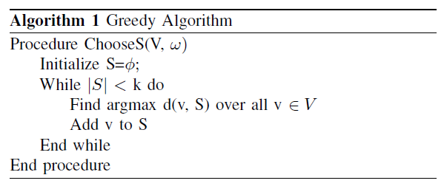
Uncapacitated Problem – Greedy Algorithm
> 2 OPT
v
U
OPT >
OPT >
> 2 OPT
Notes:
Pigeonhole

Slide 7
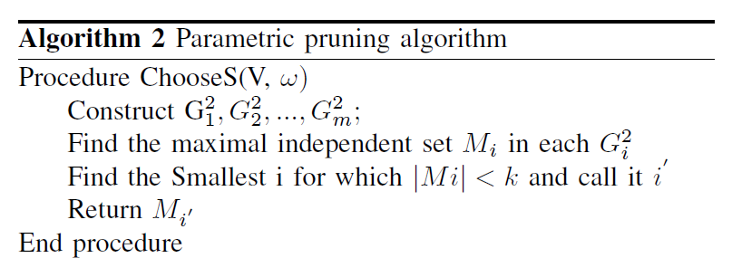
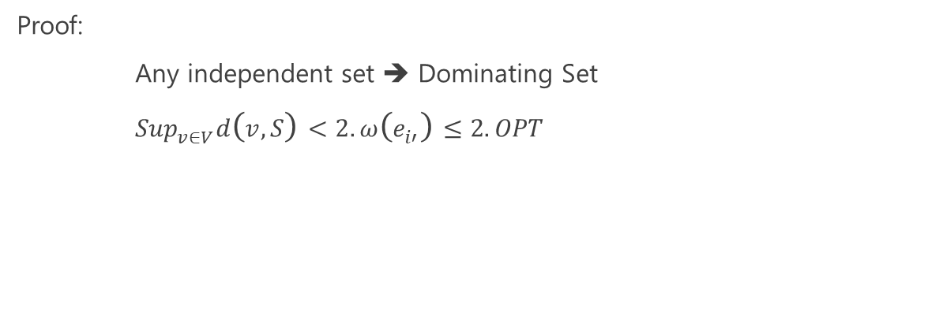
Uncapacitated Problem – Parametric Pruning
Estimate optimal solution: t
Prune the graph with weights higher than 2t
Construct the square graphs
Polynomial Time
Proof:
Any independent set ➔ Dominating Set
${Sup}_{v∈V}d\left(v,S\right)<2.ω\left(e_{i′}\right)≤2. OPT$
Notes:
Definition of Independent Set
Definition of Dominating Set
What is Square graph?

Slide 8
Capacitated Problem – 9-Approximation Algorithm
Reduce to an unweighted graph
Guess τ
Check feasibility ➔ Open k-vertices and assign vertices
Determine fraction each vertex to be opened
Cluster nodes ➔ Each cluster has at least total 1 opening variable
Transfer openings within each cluster:

Slide 9
References
Hyung-Chan An, Aditya Bhaskara, and Ola Svensson. Centrality of trees for capacitated k-center. CoRR, abs/1304.2983, 2013. URL http://arxiv.org/abs/1304.2983.
Kirtan Padh, Ola Svensson and Ashkan Norouzi-Fard. The k-center problem, 2015
Teolo F. Gonzalez. Clustering to minimize the maximum intercluster distance. Theoretical Computer Science, 38(0):293 { 306, 1985. ISSN 0304-3975. doi: http://dx.doi.org/10.1016/0304-3975(85)90224-5. URLhttp://www.sciencedirect.com/science/article/pii/0304397585902245.
D. S. Hochbaum and D. B. Shmoys. A Best Possible Heuristic for the k-Center Problem. Mathematics of Operations Research, 10:180{184, 1985. doi: 10.1287/moor.10.2.180.

